Slide 1
Distributed yet unified information sharing in Federal government
Information Sharing and Federated Identity Community of Practice 17th October, 2019
By Nicholas J. Car
Data Systems Architect, SURROUND Australia Pty Ltd
Co-Chair, Australian Government Linked Data Working Group
http://linked.data.gov.au

Slide 2
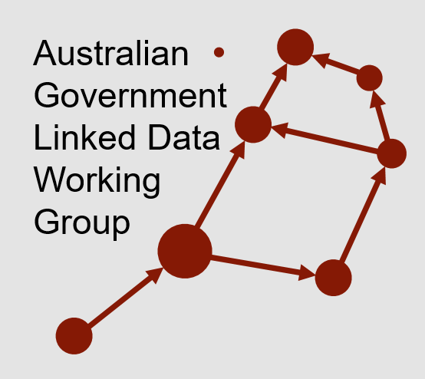
Distributed yet unified information sharing in Federal government
Information Sharing and Federated Identity Community of Practice 12th September, 2019
By Nicholas J. Car
Data Systems Architect, SURROUND Australia Pty Ltd
Co-Chair, Australian Government Linked Data Working Group
http://linked.data.gov.au
{
my role today

Slide 3
Outline
Background
Reflections on NISA, 2018
DIPA
Hubs
Spines
Rollout
Additions
Implications

Slide 4

Backgrounding
https://www.linkedin.com/in/nicholascar/
nicholas.car@surroundaustralia.com
About Nicholas
Data Systems Architect at a Semantic Data + AI company
A computer scientist at CSIRO for 15 years
Previously the Data Architect at Geoscience Australia
Now working for GSQ’s Geoscience Data Modernisation Program
Specializes in semantic data systems
Is a World Wide Web consortium standards editor

Slide 5
Backgrounding
https://www.linkedin.com/in/nicholascar/
nicholas.car@surroundaustralia.com
About Nicholas
Also representing the: Australian Government Linked Data Working Group
Inter-departmental/governmental collaboration
data management by and for government

Slide 6
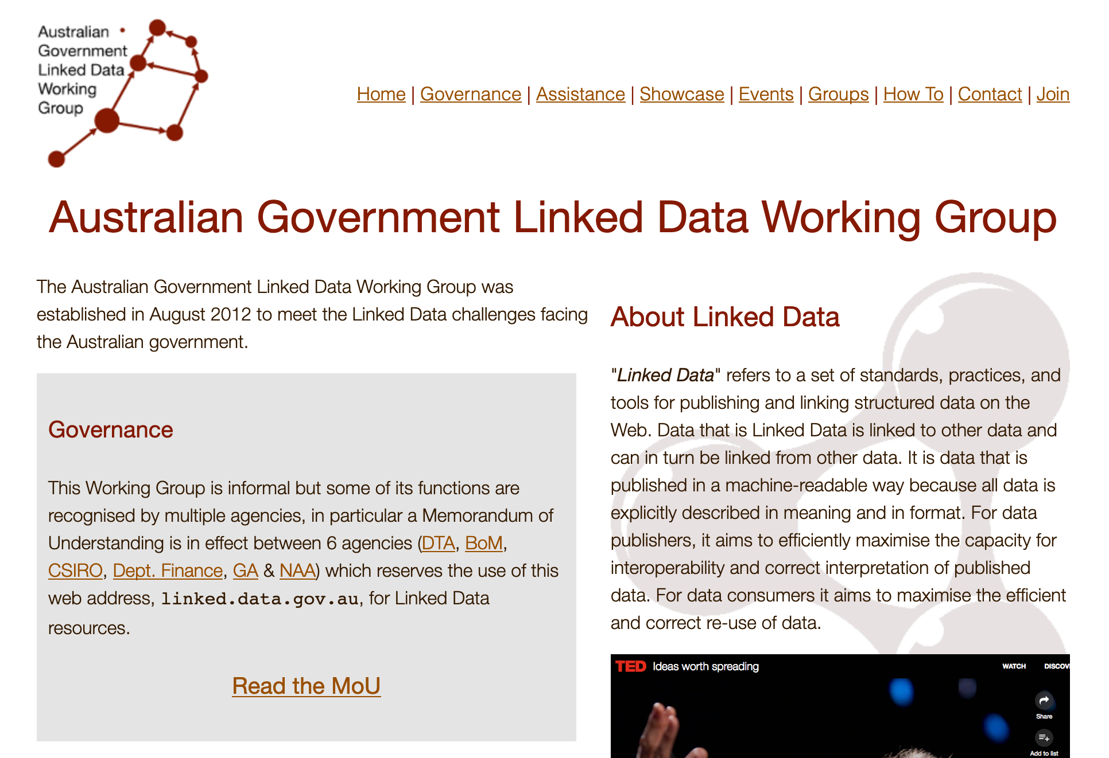
Backgrounding
https://www.linkedin.com/in/nicholascar/
nicholas.car@surroundaustralia.com
About Nicholas
Also representing the: Australian Government Linked Data Working Group
Inter-departmental/governmental collaboration on data management by and for government
← http://linked.data.gov.au

Slide 7
Backgrounding
National Innovation & Science Agenda, 2015
Prime Minister Turnbull said, in 2015:
“Australian government entities will make non-sensitive data open by default to contribute to greater innovation and productivity improvements across all sectors of the Australian economy”
What is being done?

Slide 8
Backgrounding
National Innovation & Science Agenda, 2015
Prime Minister Turnbull said, in 2015:
“Australian government entities will make non-sensitive data open by default to contribute to greater innovation and productivity improvements across all sectors of the Australian economy”
What is being done?

Slide 9
Backgrounding
National Innovation & Science Agenda, 2015
What is being done?
Data Integration Partnerships for Australia
Hubs
Spines

Slide 10

DIPA – “hubs”
Government Data
Business Data
Environmental Data
Themed large, secure environments for data analytics

Slide 11

DIPA – “spines”
Government Data
Business Data
Environmental Data
Reference points for data cross-linking

Slide 12
DIPA – “spines”
Government Data
Business Data
Environmental Data
This is my area!
Reference points for data cross-linking

Slide 13

DIPA – location spine
Government Data
Business Data
Environmental Data
Almost everything is somewhere

Slide 14

DIPA – structural spines
Government Data
Business Data
Environmental Data
All government data relates to government

Slide 15

DIPA – spine of spines
Government Data
Business Data
Environmental Data
Mechanics for data identity link everything

Slide 16
Spines rollout
Select mechanics for identity

Slide 17


Spines rollout
Select mechanics for identity

Slide 18
Spines rollout
Select mechanics for identity
common data formats and exchange protocols on the Web

Slide 19
Spines rollout
Select mechanics for identity
common data formats and exchange protocols on the Web
web of data

Slide 20
Spines rollout
Select mechanics for identity
common data formats and exchange protocols on the Web
an integrated set of formal data models

Slide 21
Spines rollout
Select mechanics for identity
common data formats and exchange protocols on the Web
an integrated set of formal data models
Modern data modelling, regardless of the web component

Slide 22
Spines rollout
Select mechanics for identity
Provide specific things with identity
Spatial
Organisational

Slide 23
Spines rollout
Select mechanics for identity
Provide specific things with identity
Spatial
Spatial Linking Authority – being formed for creating authoritative IDs

Slide 24
Spines rollout
Select mechanics for identity
Provide specific things with identity
Spatial
Spatial Linking Authority – being formed for creating authoritative IDs
LocI – integrated spatial datasets, ever increasing

Slide 25
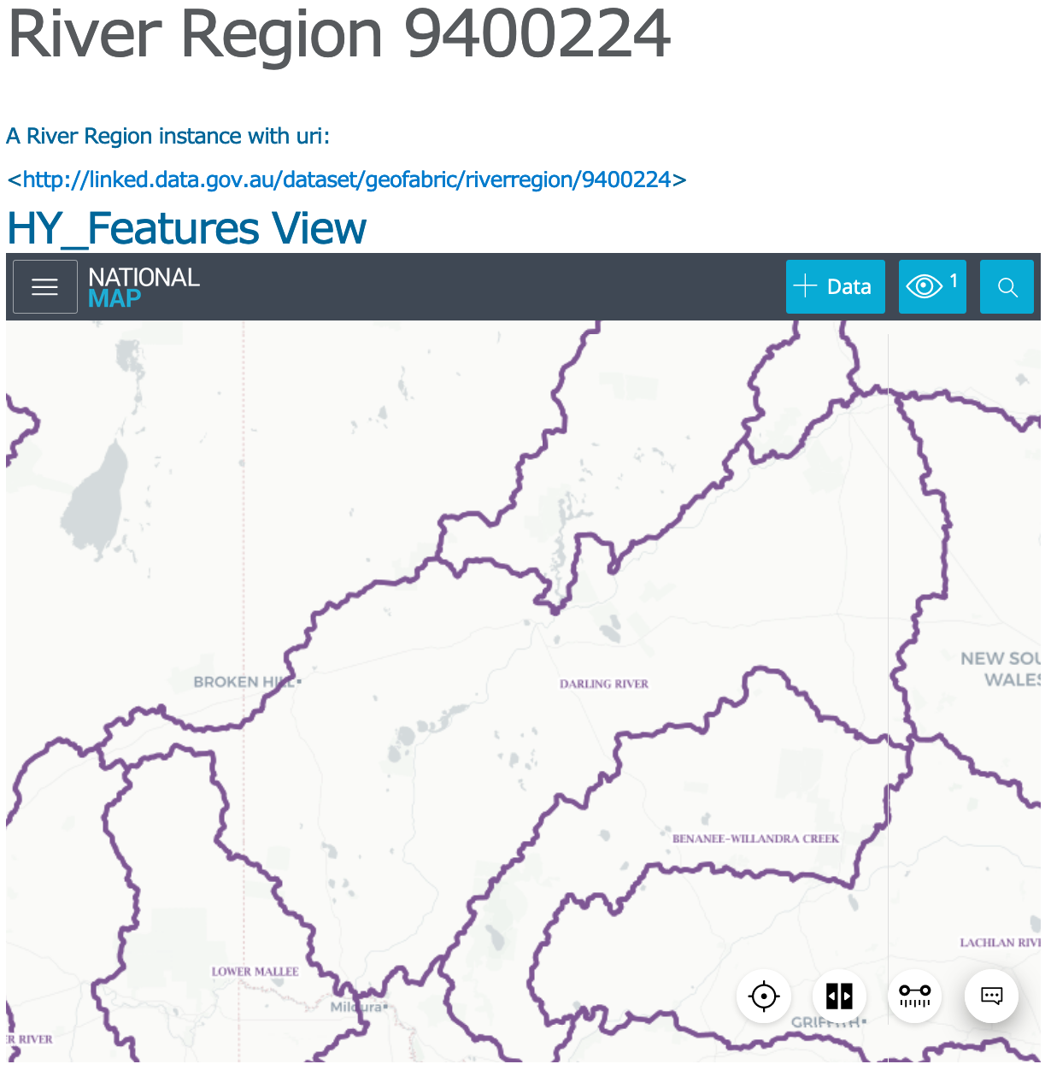
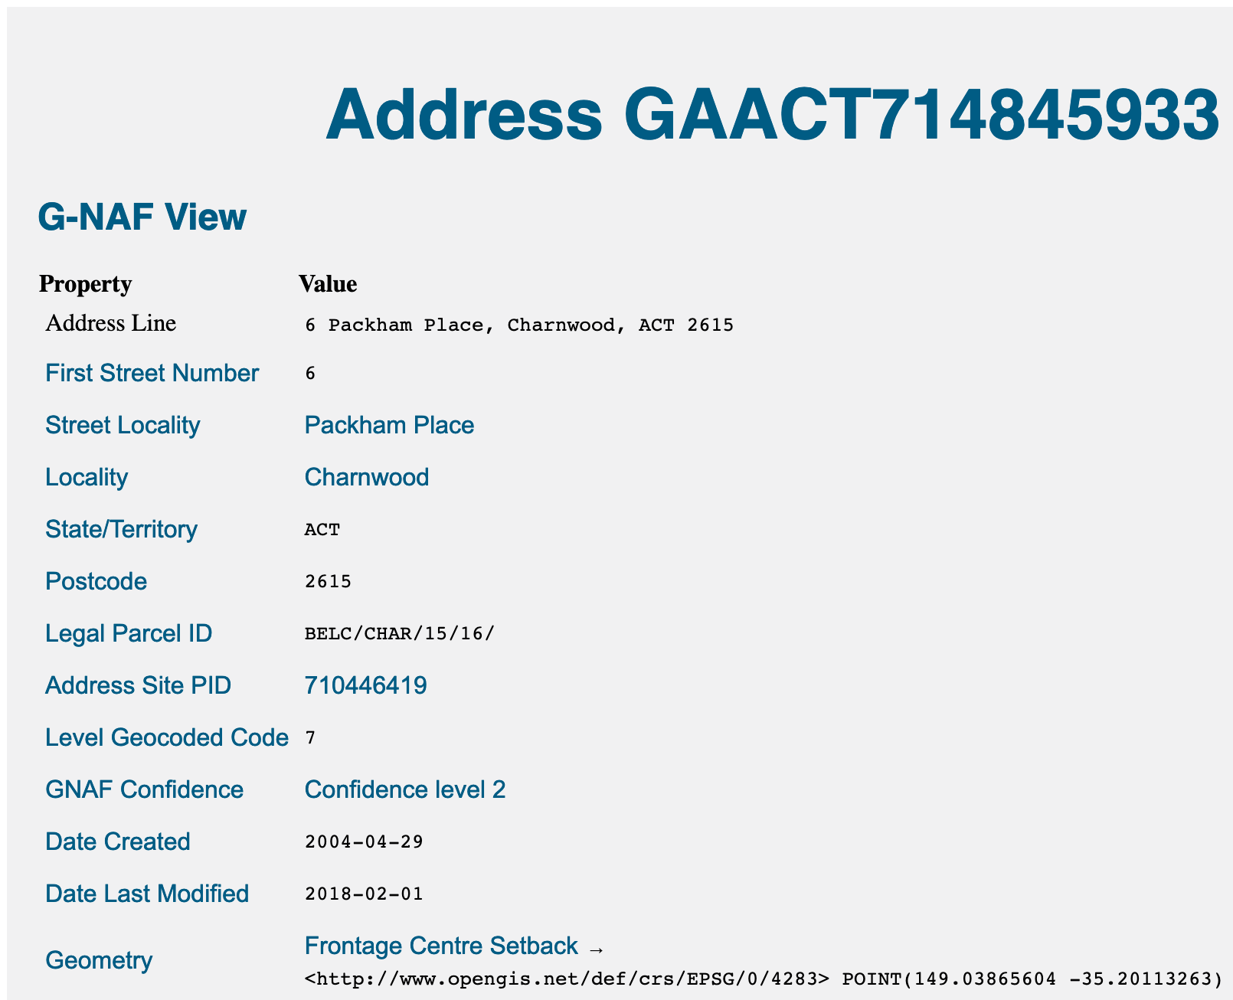
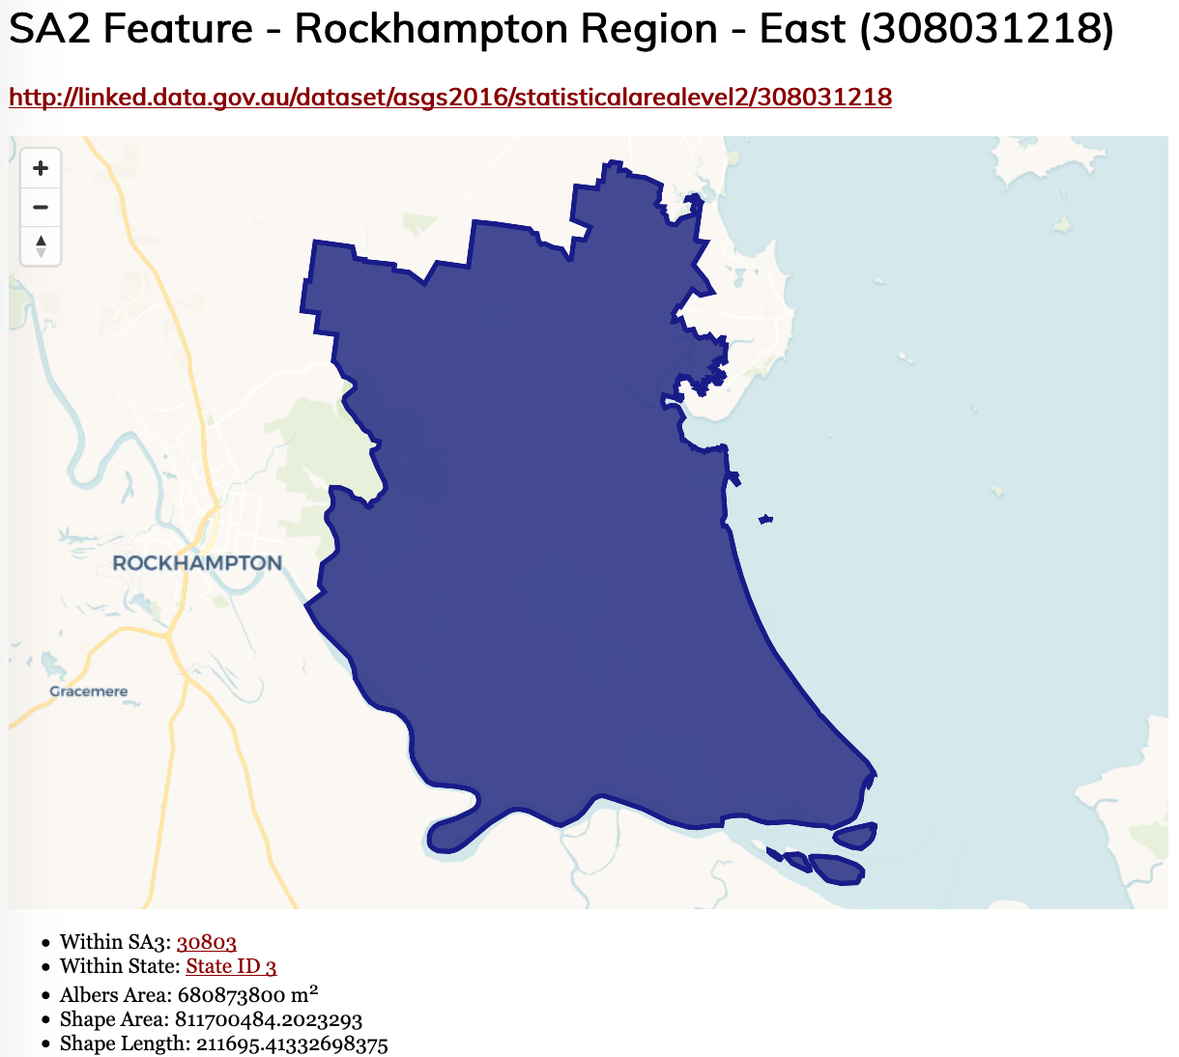
Spines rollout - LocI
Environmental data
– Geofabric
Address data
- GNAF
Statistical areas
- ASGS

Slide 26
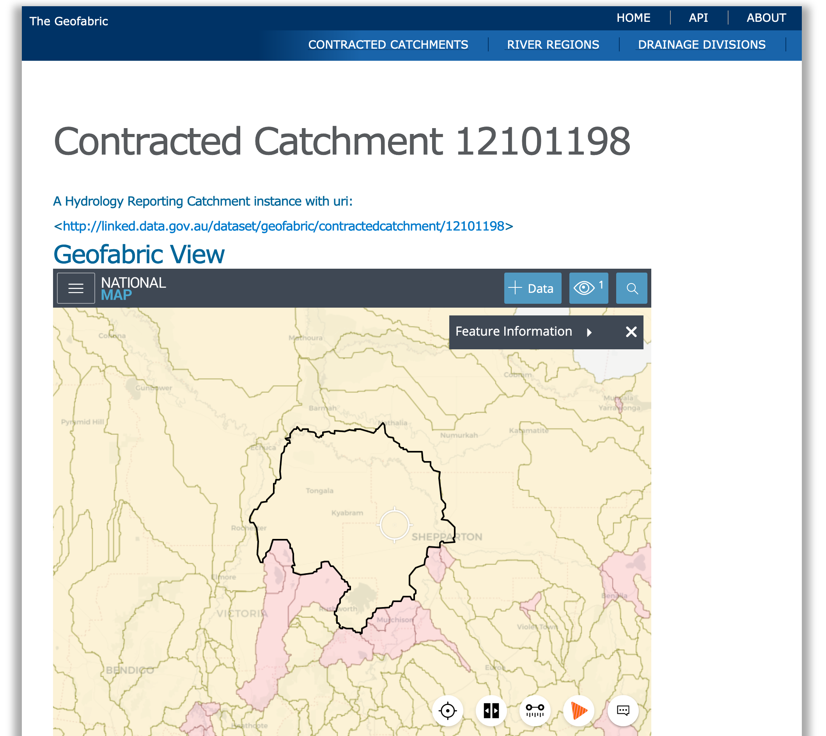
Spines rollout – LocI: Geofabric
Previously already public data
Now public semantic data

Slide 27
Spines rollout – LocI: Geofabric
Previously already public data
Now public semantic data
All items formally defined
A “Catchment” and how they relate to other things is given

Slide 28
Spines rollout – LocI: Geofabric
Previously already public data
Now public semantic data
All items formally defined
All individual things have web addresses
http://linked.data.gov.au/contractedcatchment/12101198

Slide 29
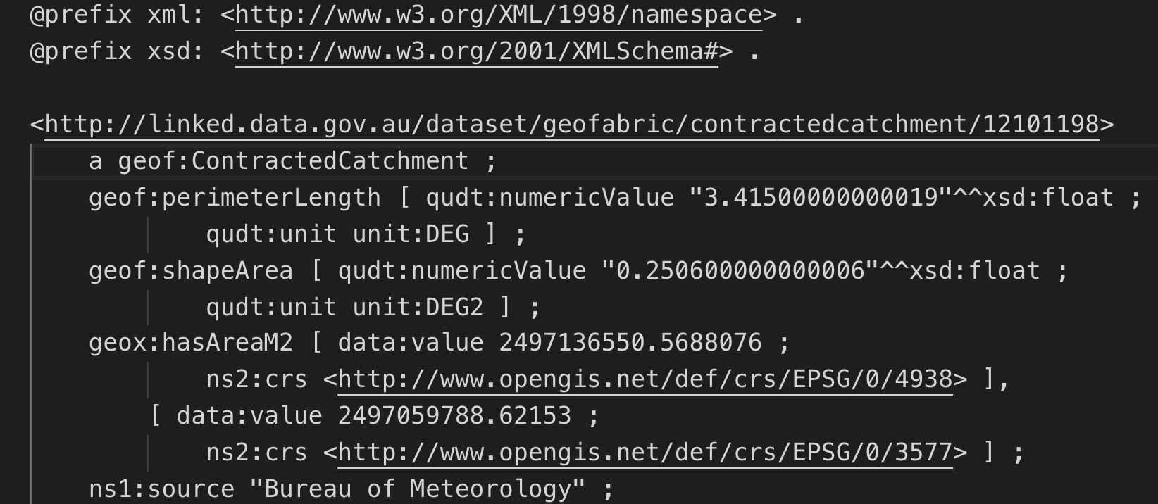
Spines rollout – LocI: Geofabric
Previously already public data
Now public semantic data
All items formally defined
All individual things have web addresses
Human & machine versions of data
https://liked/data.giv.au/contractedcatchment/12101198

Slide 30
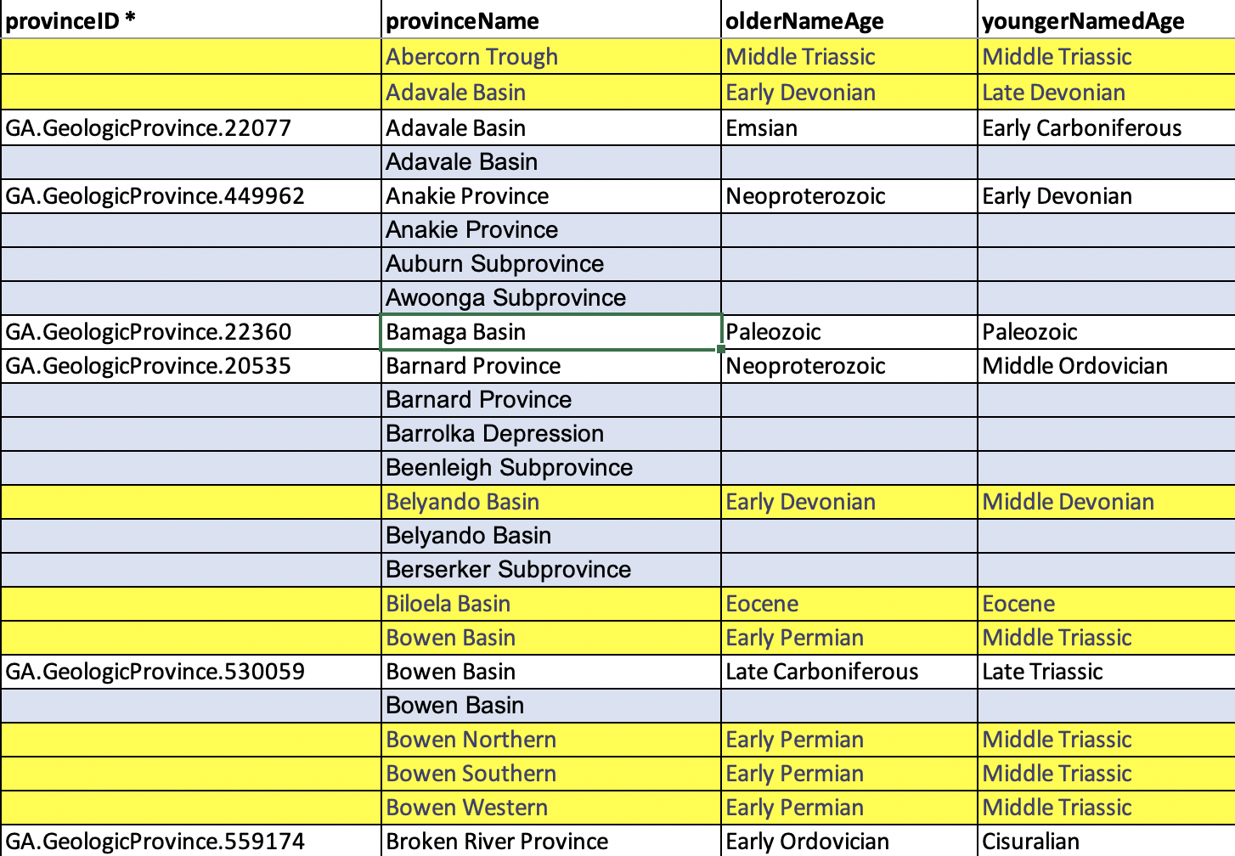
Spine Addition – GSQ Basins
GSQ has already published a list of geological basins via Qld Spatial Catalogue
At GSQ I will be ’wrapping’ that data with publication tool, making it LocI compatible
This will bring in additional metadata
We can associate geological basins & the Geofabric through formal modelling
Spatial information + other metadata, such as geological properties

Slide 31
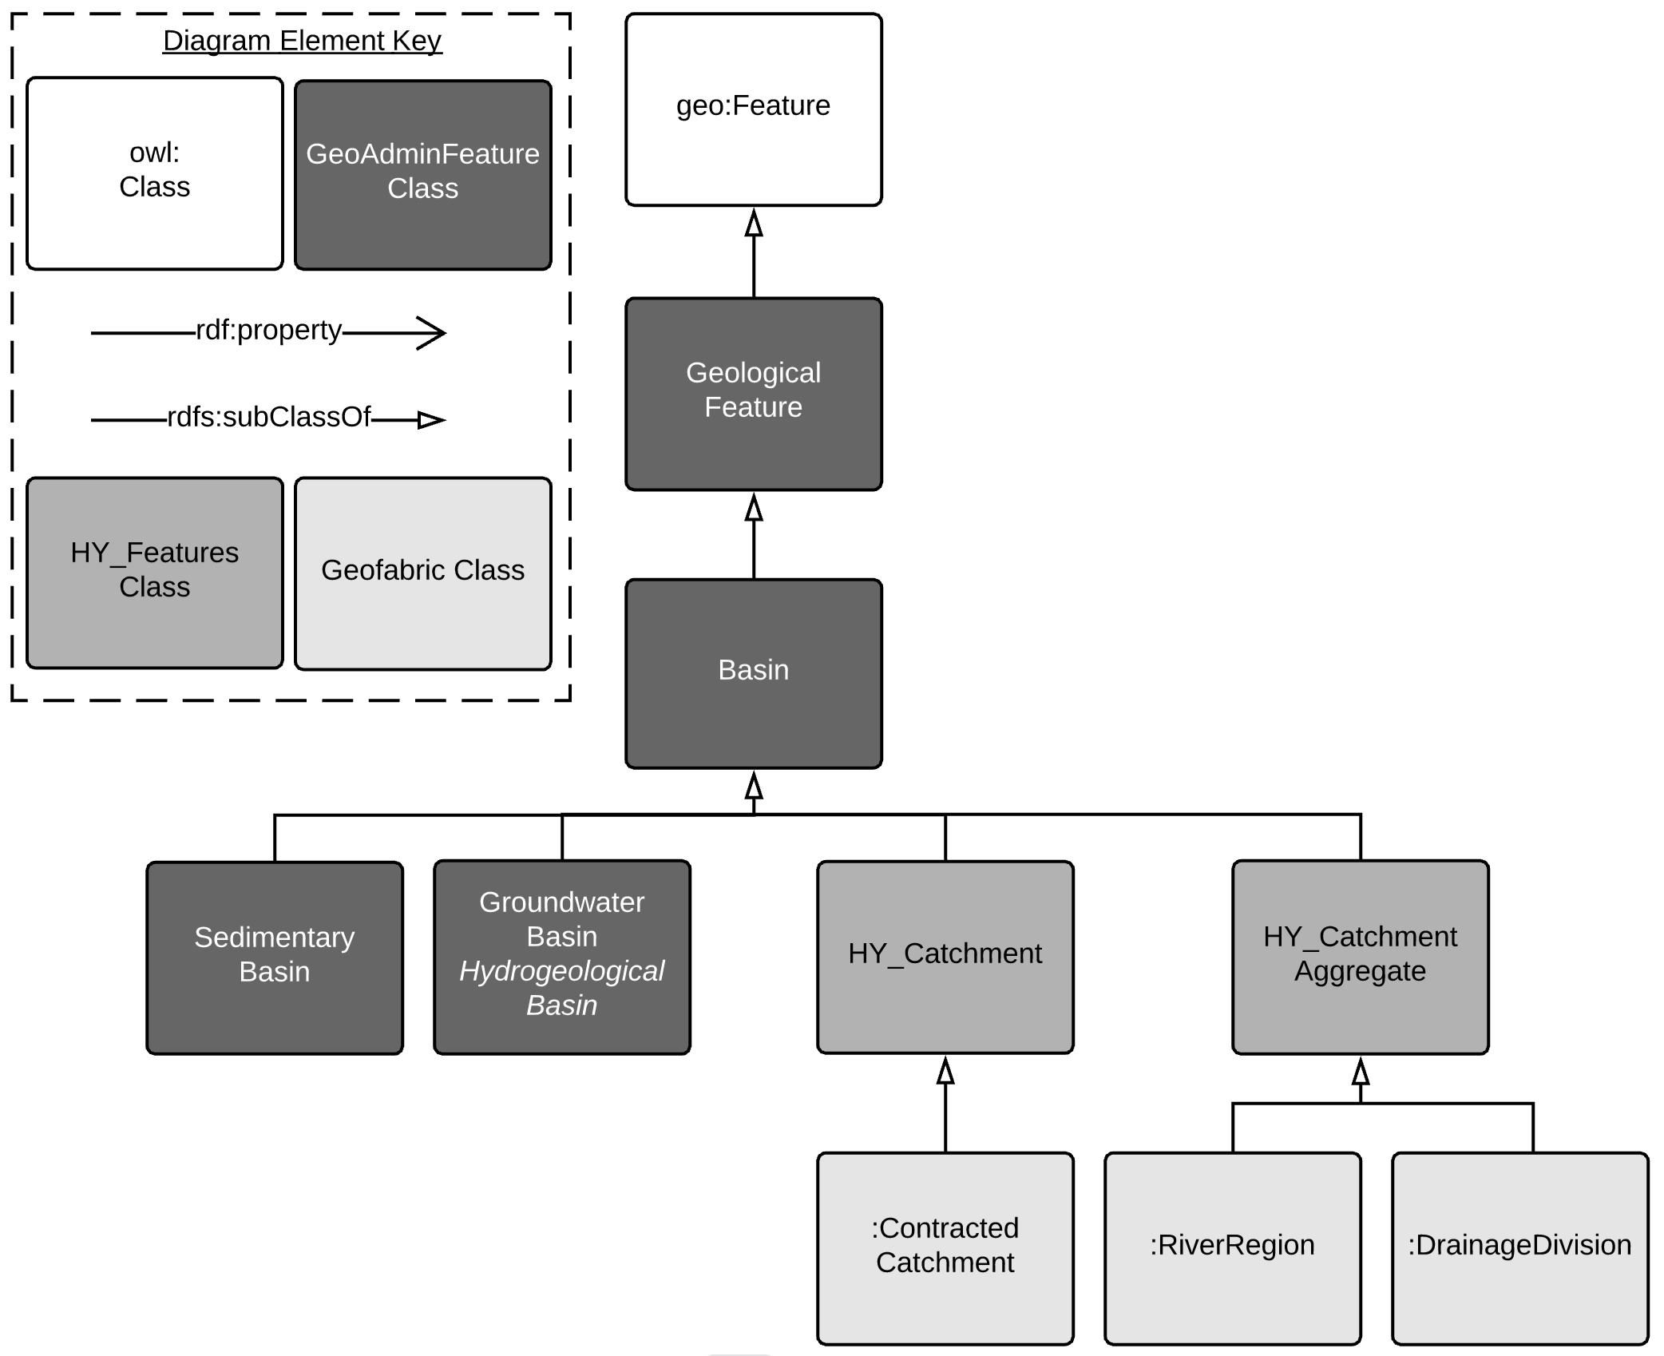
Spine Addition – GSQ Basins
Part of GSQ’s GeoAdmin Features model

Slide 32
Spine Addition – GSQ Basins
GSQ has already published a list of geological basins via Qld Spatial Catalogue
At GSQ I will be ’wrapping’ that data with a layer, making it LocI compatible
This will bring in additional metadata
We can associate geological basins & the Geofabric through formal modelling
This will allow data apportioned according to GSQ Basins to be reapportioned according to any LocI dataset
GSQ will publish more spatial layers than just basins
GSQ will also publish data – Properties of Interest of features

Slide 33
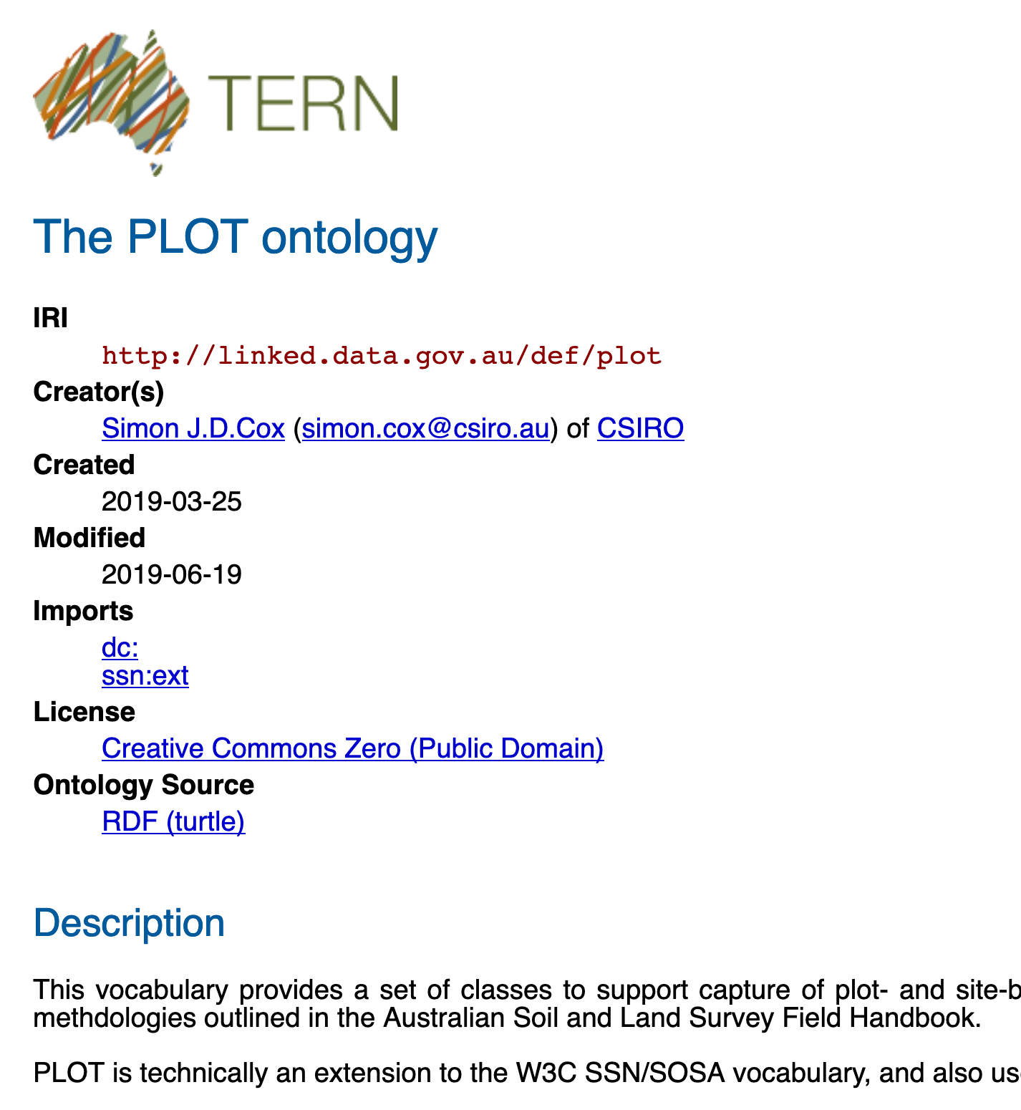
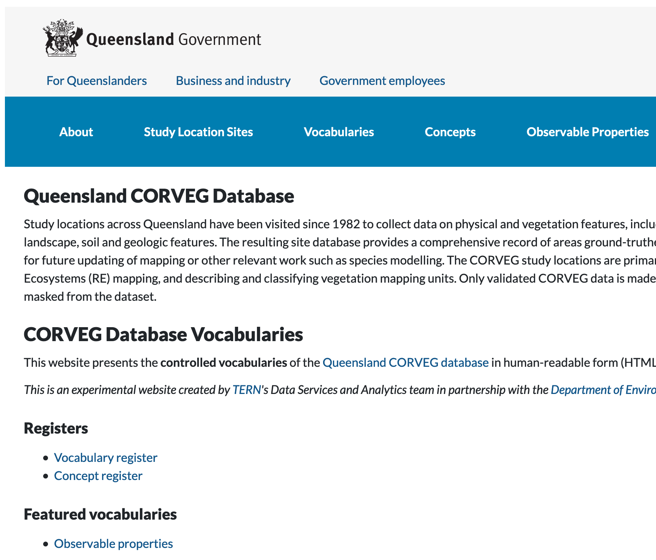
Spine Addition – DES CorVeg Sites
DES, through the Terrestrial Ecosystem Research Network (TERN), have released their CorVeg dataset in a LocI-compatible form
CorVeg information is now available according to the PLOT Ontology

Slide 34
Spine Addition – DES CorVeg Sites
DES, through the Terrestrial Ecosystem Research Network (TERN), have released their CorVeg dataset in a LocI-compatible form
This means CorVeg data will be able to be reapportioned according to any LocI dataset and vegetation & mineral data joined

Slide 35
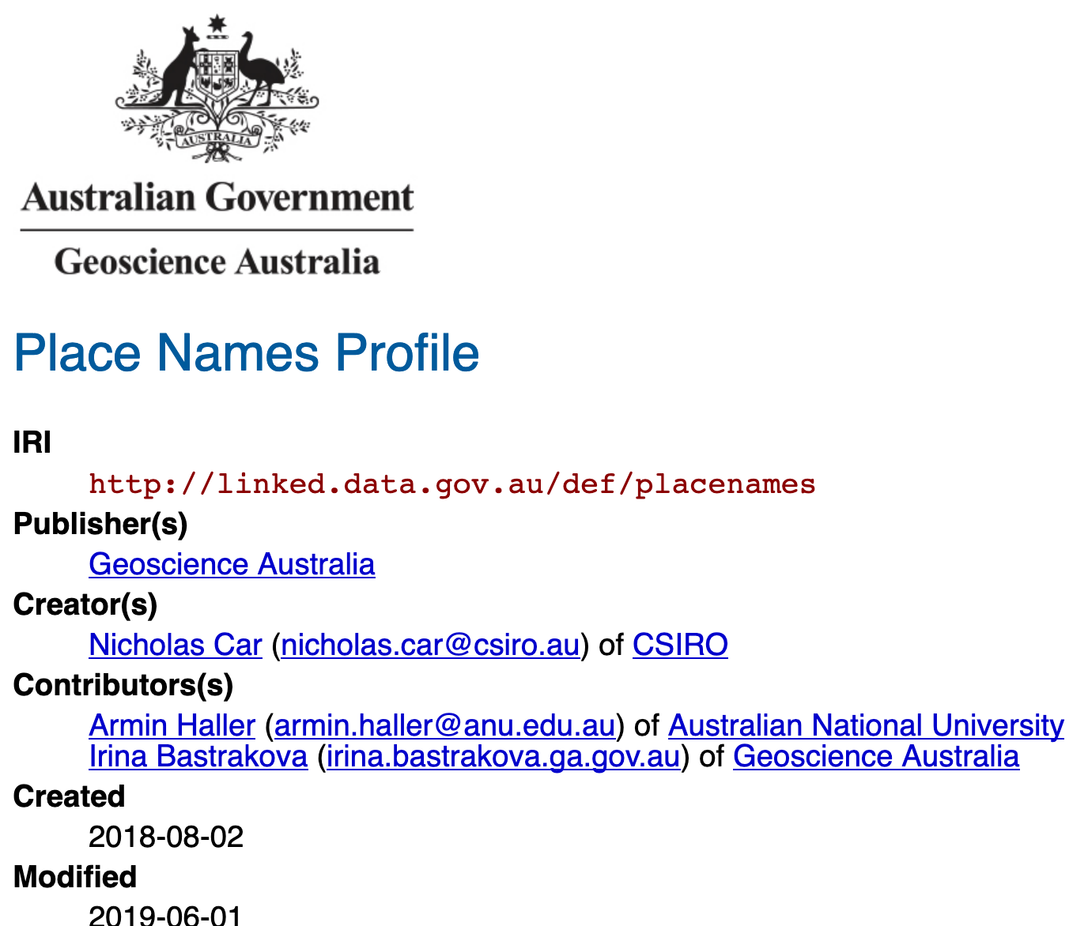
Spine Addition – National
Place Name gazetteer of Australia (ANZLIC, GA & DNRME)
Multi-state Cadaster
BoM water data
…
Integration with next-gen Geoprocessing
Discreet Global Grid
Your Data, Your Regions

Slide 36
Spine Use with data
GSQ Mineral Properties
DES CorVeg
Other LocI Data
Agency Data, independently published
But according to a set of shared models
Associated with spatial layers in particular ways
Can be aggregated (or partly aggregated)
Totlal aggregation Partial aggregation

Slide 37
Spine Use with data – Use Case
EIS automated processing
Subject of a UQ PhD
Aims to handle data, not document, submission
Needs a formal model of EIS information
Will reuse models from GSQ & DES
Will use reference data from GSQ & DES

Slide 38
Spines rollout
Select mechanics for identity
Provide specific things with identity
Spatial
Organisational

Slide 39
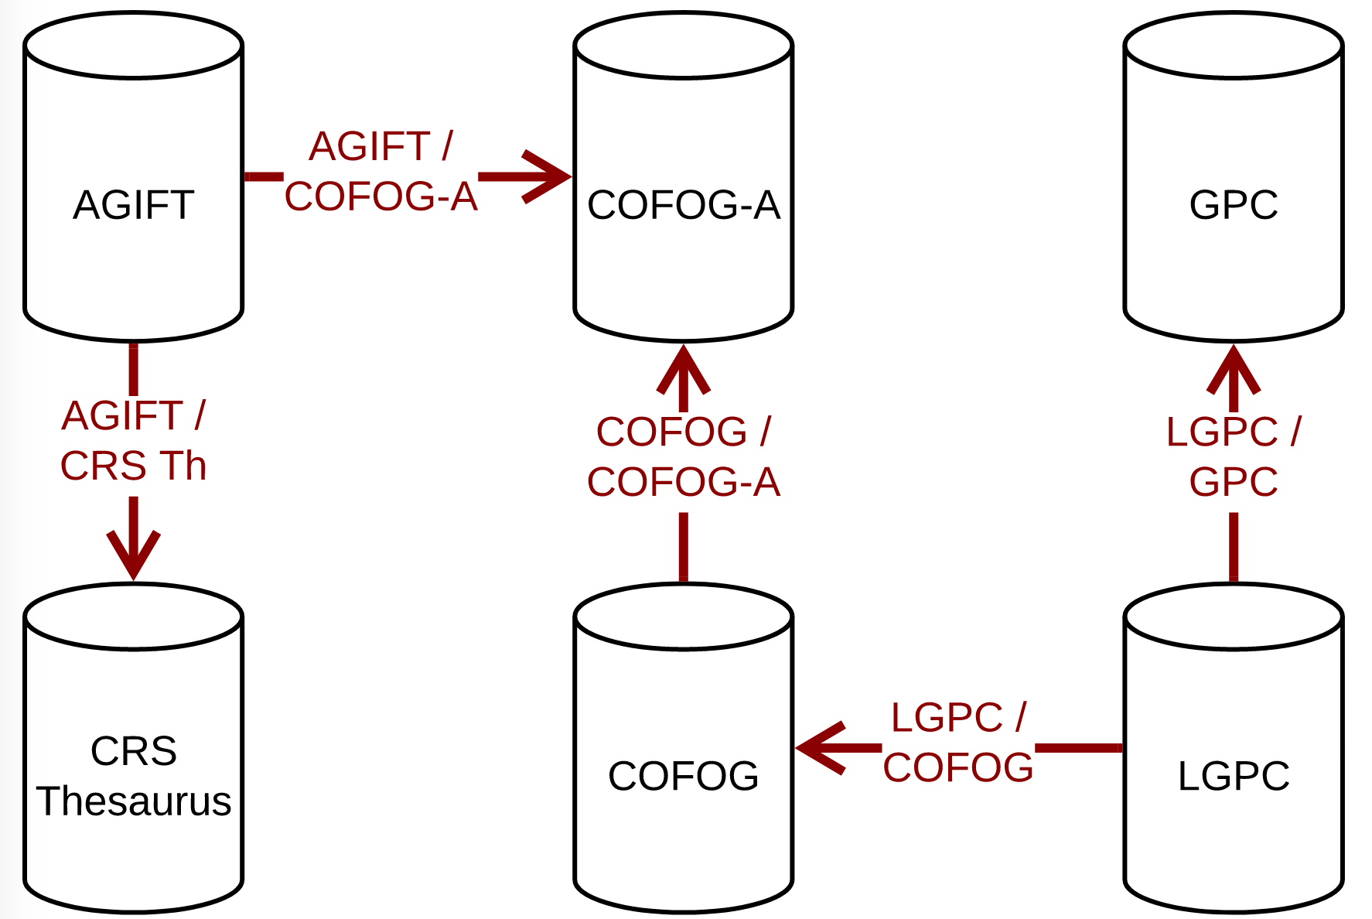
Spines rollout - LongSpine
Multiple structural taxonomies mapped

Slide 40
Spines rollout - LongSpine
Multiple structural taxonomies mapped
Mappings published separately for individual governance

Slide 41
Spines rollout - LongSpine
Multiple structural taxonomies mapped
Mappings published separately for individual governance
This is a dataset

Slide 42
Spines rollout - LongSpine
Multiple structural taxonomies mapped
Mappings published separately for individual governance
Models formalised and aligned

Slide 43
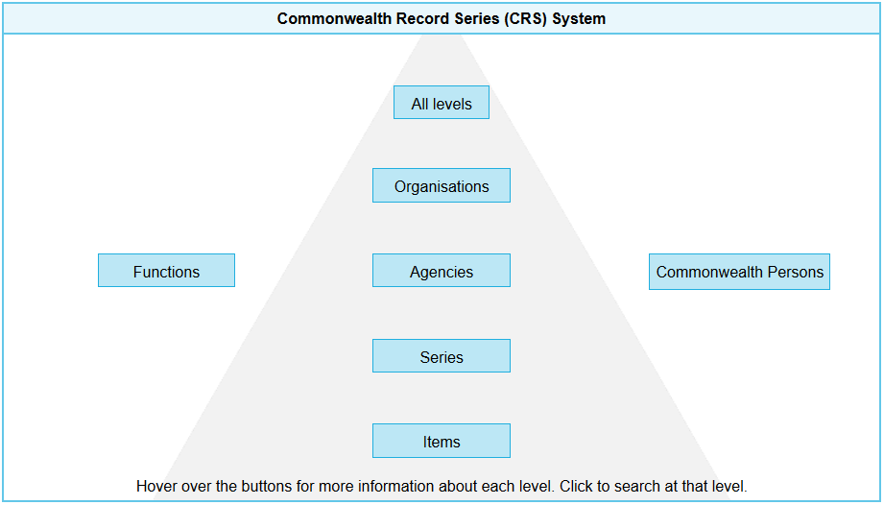
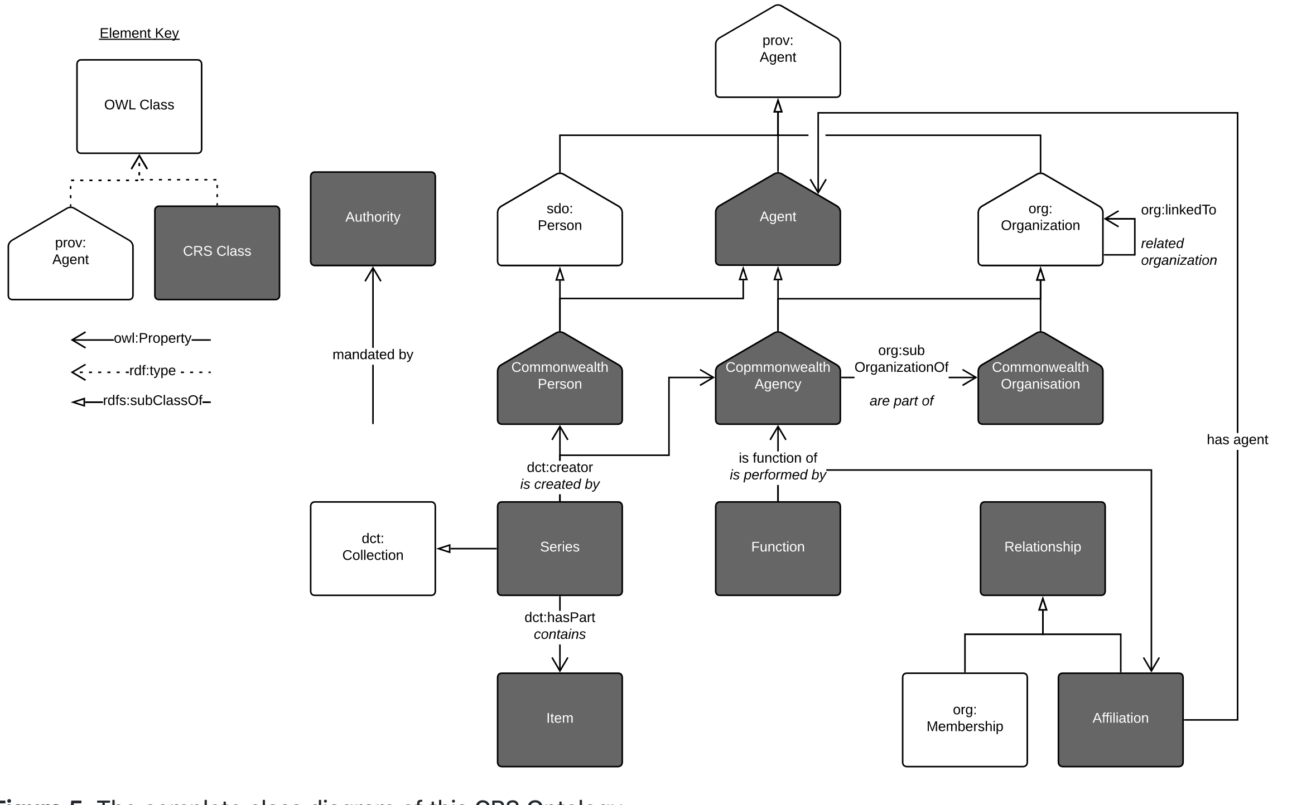
Informal to Formal

Slide 44
Spines governance
Distributed by nature

Slide 45
Spines governance
Distributed by nature
Everyone must follow the rules

Slide 46

Spines governance
Distributed by nature
Everyone must follow the rules
Some rules are now becoming compulsory

Slide 47
Spines governance
Distributed by nature
Everyone must follow the rules
Some rules are now becoming compulsory
We are establishing reference data authorities
ANZLIC - Spatial Linking Authority

Slide 48

Spines governance
Distributed by nature
Everyone must follow the rules
Some rules are now becoming compulsory
We are establishing reference data authorities
We are all hoping for data committees secretariat management (Federal & State)

Slide 49
Spines future
“numerical” data coming online as semantic data
Census data
Sensor data
Government analysis data
Cubes of data referencing the spine’s IDs and types

Slide 50
Spines future
“numerical” data coming online as semantic data
Data analytics within the
secure hubs
IDs work just fine within secure (non-open) data environments

Slide 51
Spine implications – Govt-Wide Knowledge Graph
By analogy with the GSQ Knowledge Graph…

Slide 52
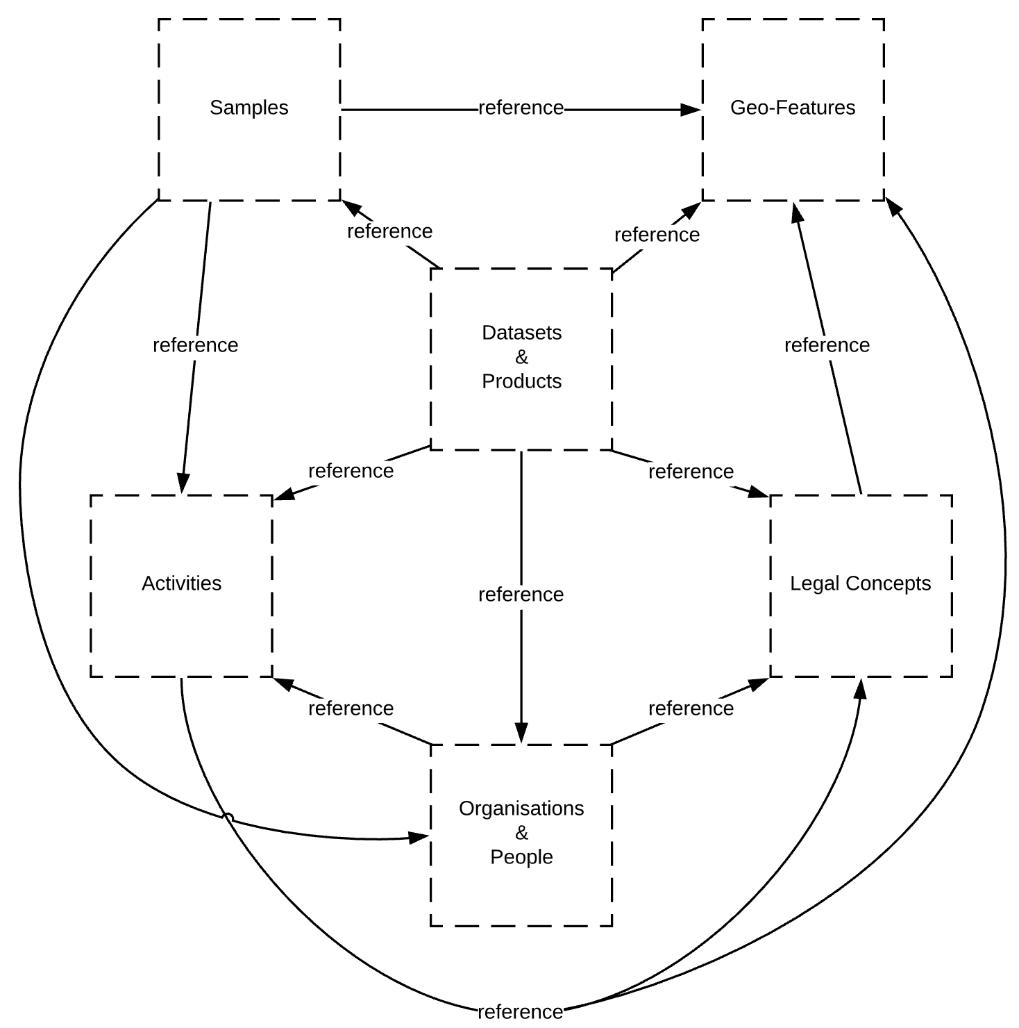
Spine implications – Govt-Wide Knowledge Graph
By analogy with the GSQ Knowledge Graph…

Slide 53
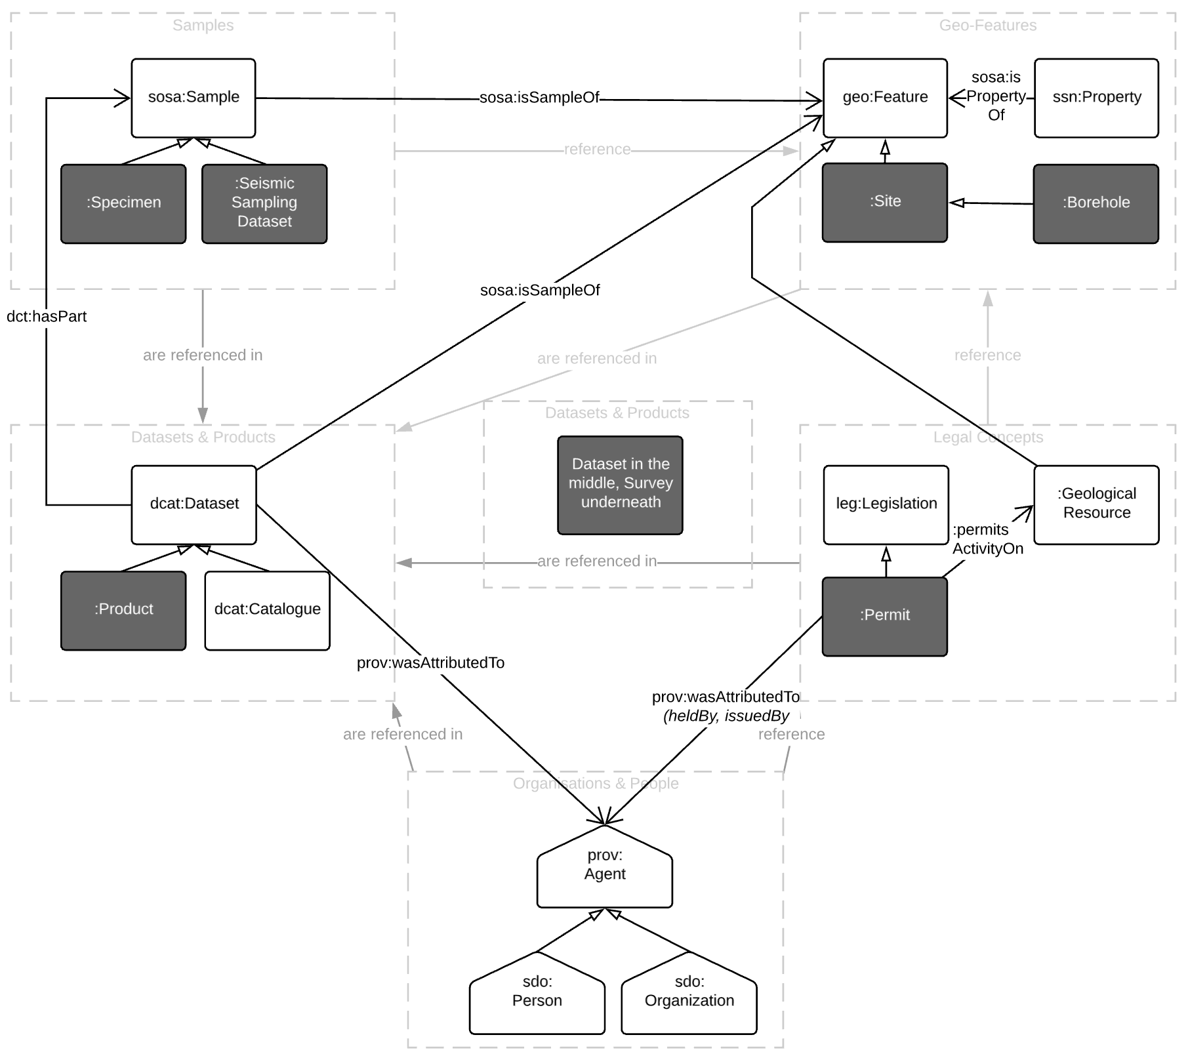
Spine implications – Govt-Wide Knowledge Graph
By analogy with the GSQ Knowledge Graph…

Slide 54
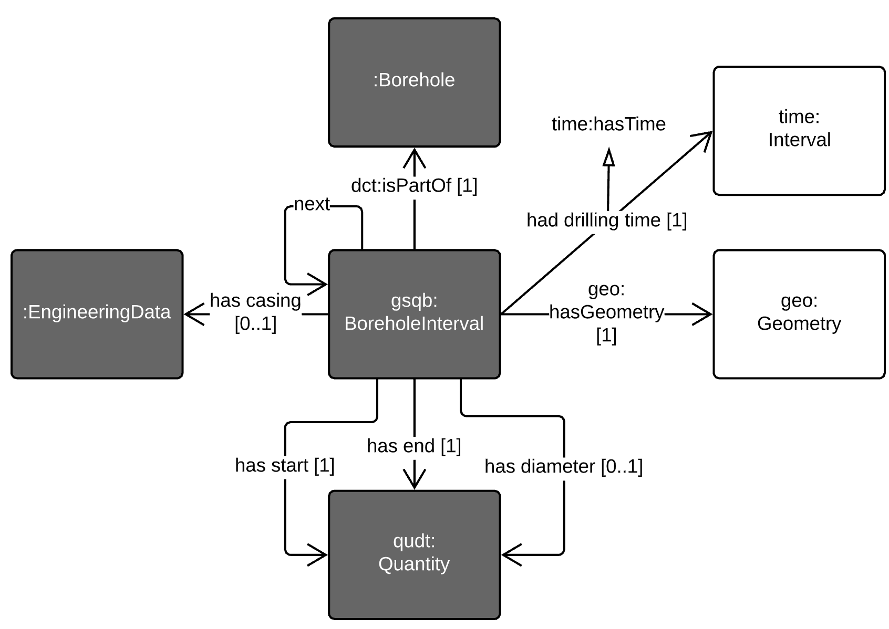
Spine implications – Govt-Wide Knowledge Graph
By analogy with the GSQ Knowledge Graph…

Slide 55
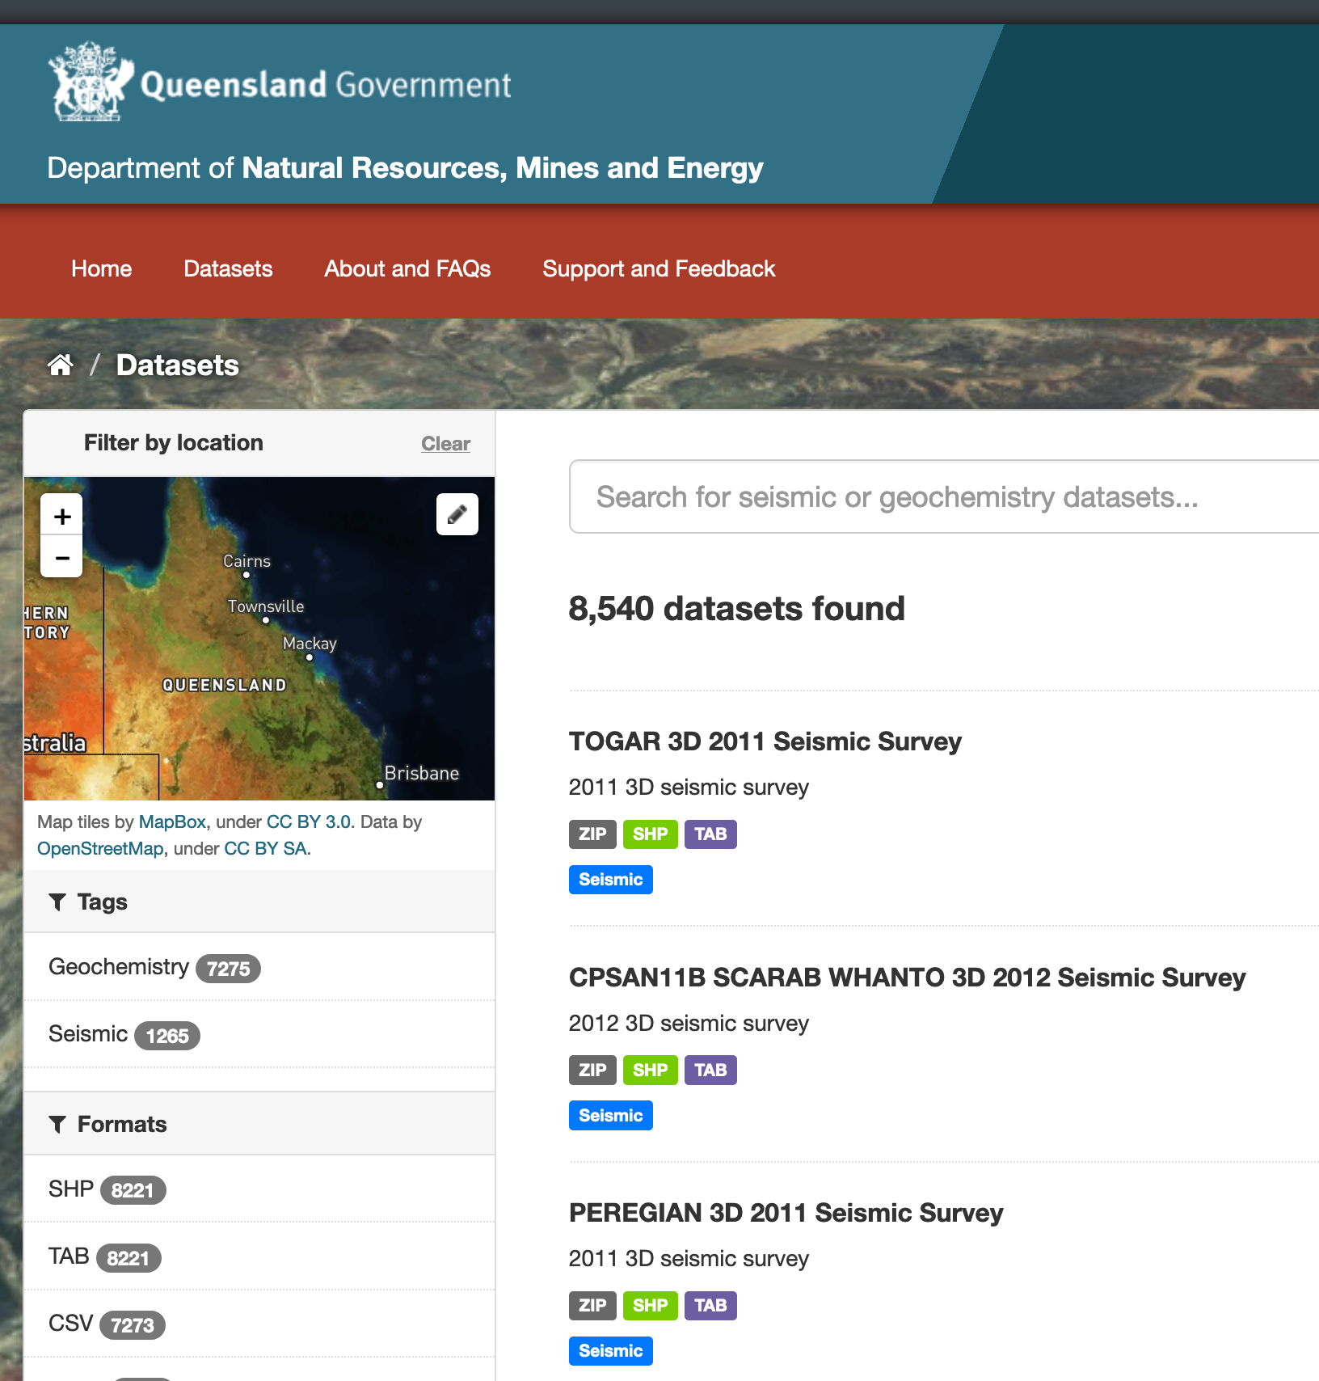
Spine implications – Govt-Wide Knowledge Graph
By analogy with the GSQ Knowledge Graph…
data for

Slide 56
Spine implications – Govt-Wide Knowledge Graph
By analogy with the GSQ Knowledge Graph…
Mapping dataset
GSQ
Borehole Data
GSQ aerial survey data
other
concepts
mapped
spatial

Slide 57
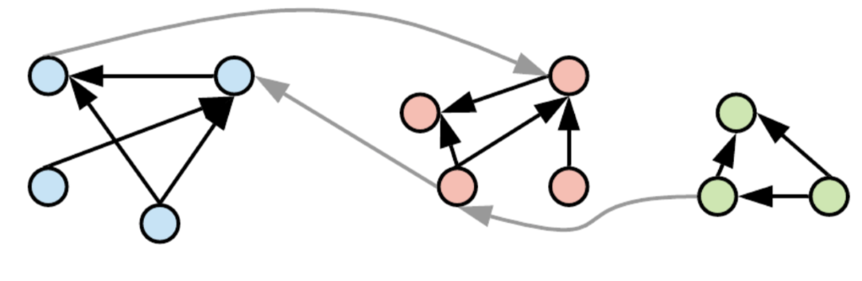
Spine implications – Govt-Wide Knowledge Graph
By analogy with the GSQ Knowledge Graph…
Multiple graphs are joined into a larger graph

Slide 58
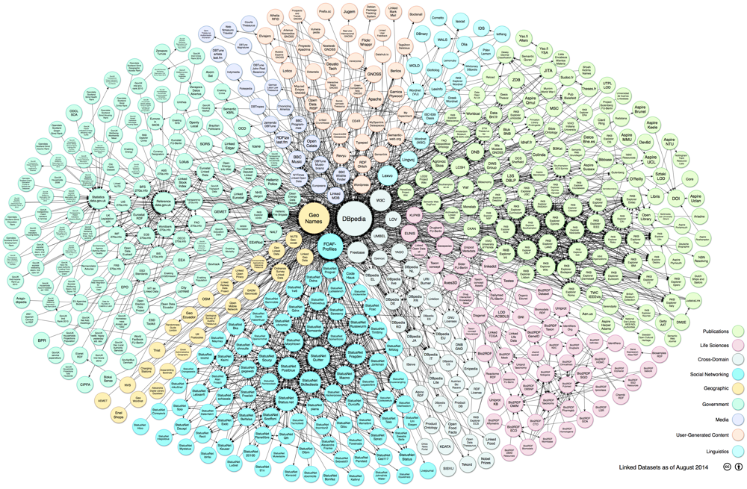
Spine implications – Govt-Wide Knowledge Graph
By analogy with the GSQ Knowledge Graph…
Our own Linked Data Cloud
https://lod-cloud.net

